Slide 1
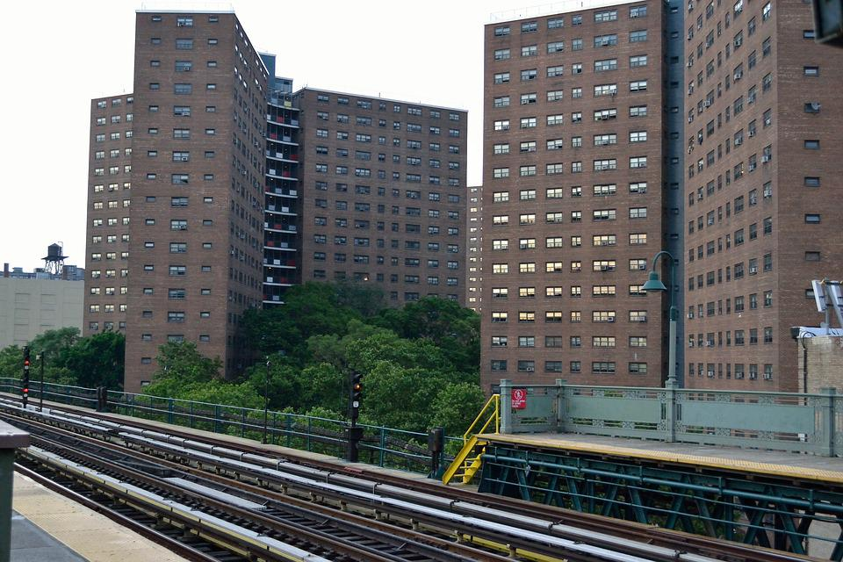

Slide 2
Data science project HOUSE PRICE PREDICTION
Submitted by:
AKANKSHA MISHRA
Batch – Internship 27

Slide 3
Problem Statement To predict Target Variable Sales Price based on 79 Features using Regression.
Houses are one of the necessary need of each and every person around the globe
Hence housing and real estate market is one of the markets which is one of the major contributors in the world’s economy.
Data science comes as a very important tool to solve problems in the domain to help the companies increase their overall revenue, profits, improving their marketing
Predictive modelling, Market mix modelling, recommendation systems are some of the machine learning techniques used for achieving the business goals for housing companies.

Slide 4
EDA
1. Checking the Missing Values
2.All the numerical Variables
3.Distribution of the Numerical Variables
4.categorical variables
5. cardinality of the categorical variables
6.Outliers
7.Relationship between dependent and independent feature(SalePrice)

Slide 5
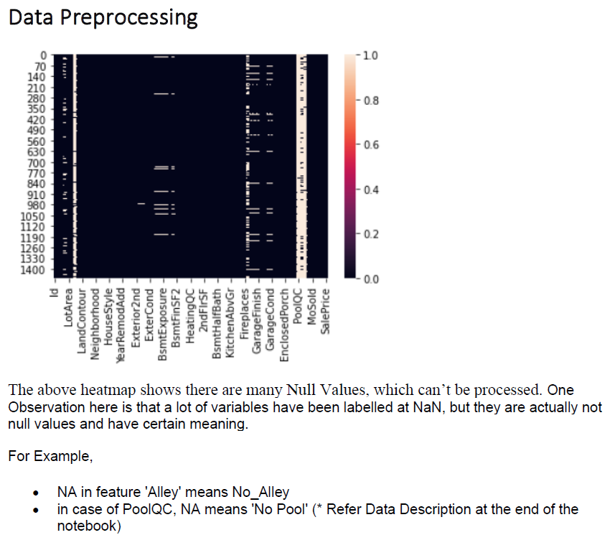
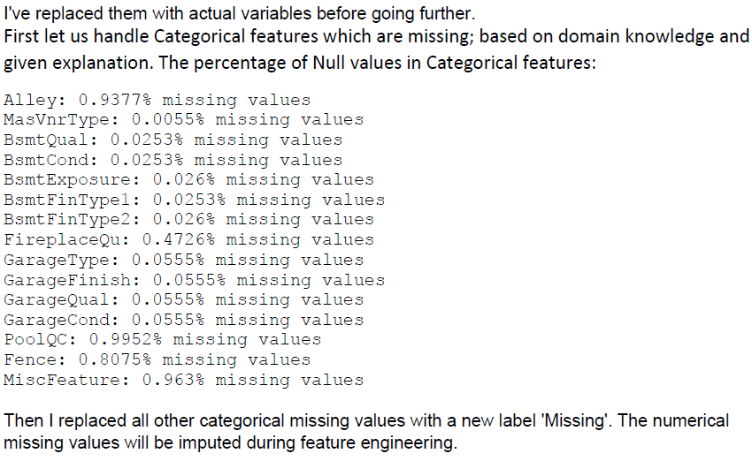
EDA Steps & Visualizations

Slide 6
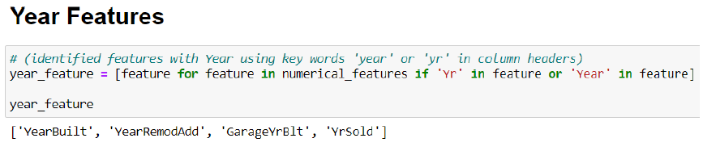
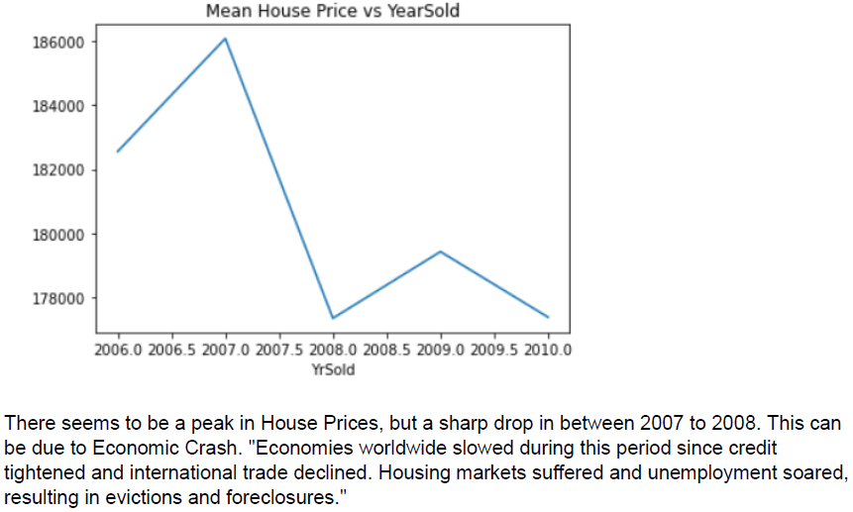
Classifying Features - Numerical
Identified all numerical features.
Out of 79, there were 37 numerical features
First Found out Temporal values (Year Features)

Slide 7
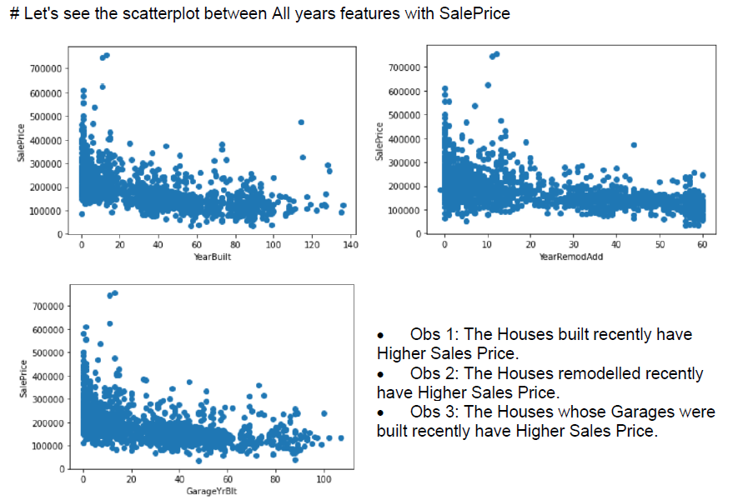
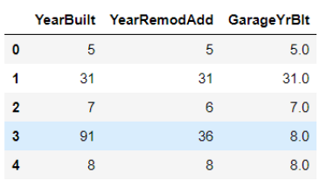
Scatterplots of Year Features vs Sales Price
Above features were created by finding difference from Year of Sale

Slide 8
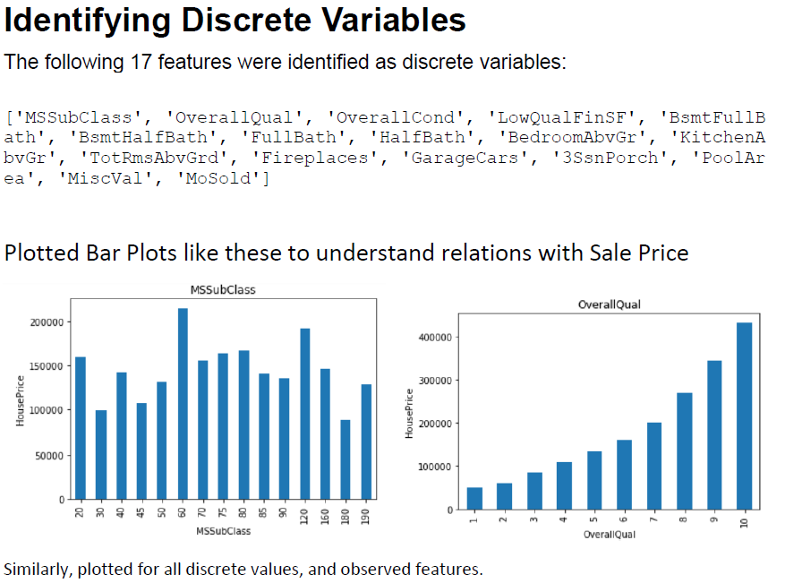
Out of 37 Numerical Features, identified 17 discrete features.

Slide 9
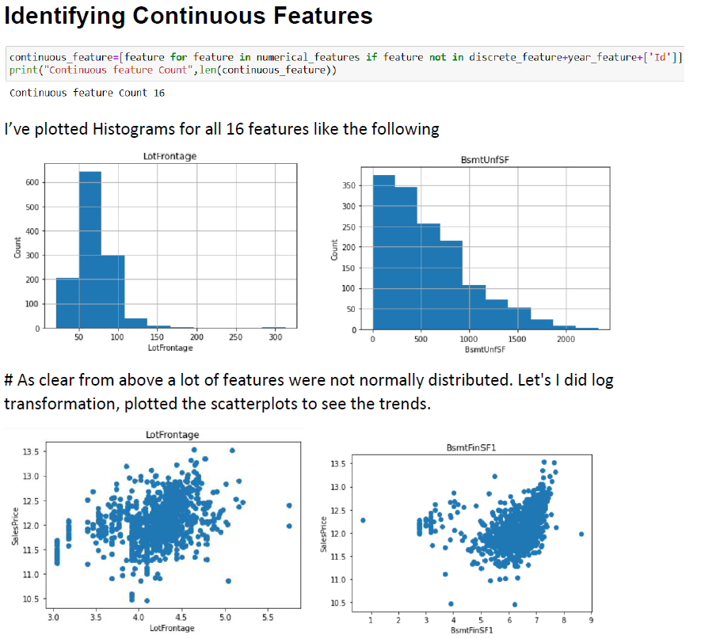
16 Continuous features out of 37 numerical features

Slide 10
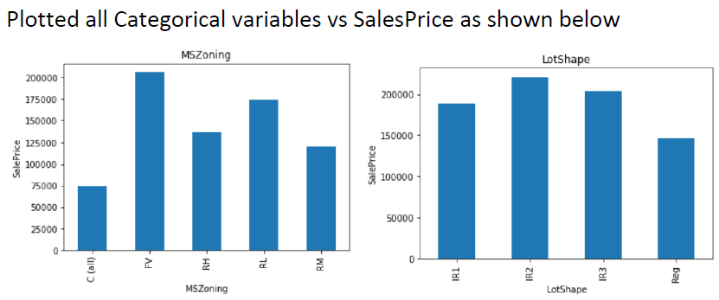
Categorical Features
Total 43 categorical Features were identified.

Slide 11
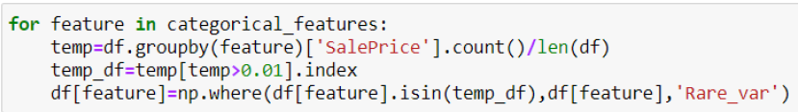
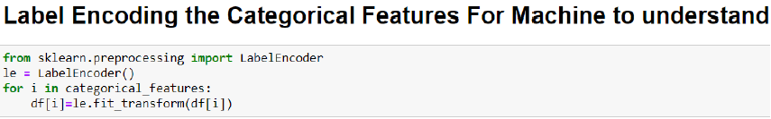
Feature Engineering Steps
Replaced categories less than 1% of total length
Training Data – 80%
Test Data – 20%
Before treating skewness with log1p transformation, divided data into train and test data, to avoid data leakage.

Slide 12
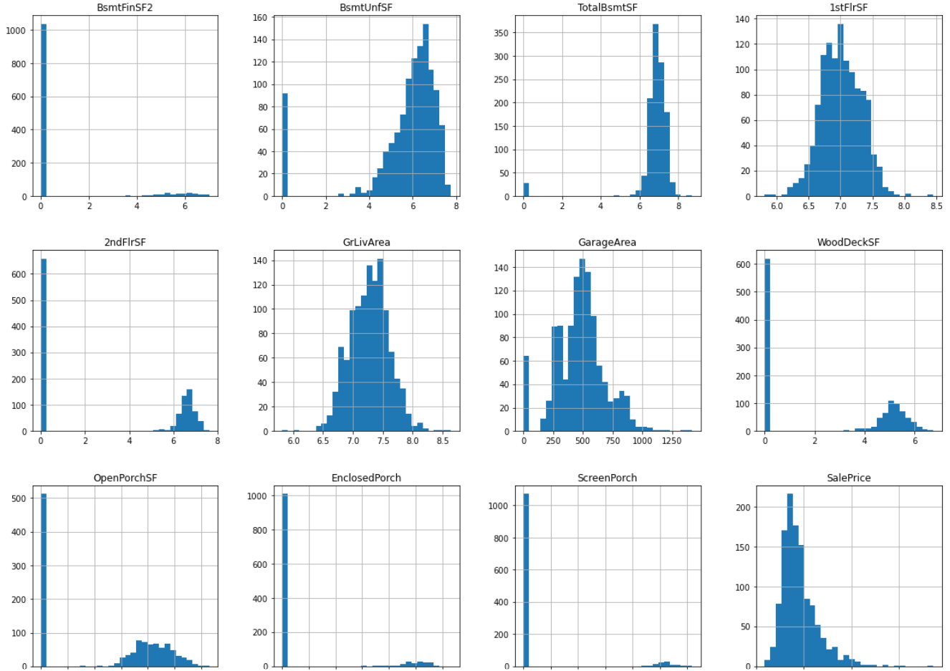
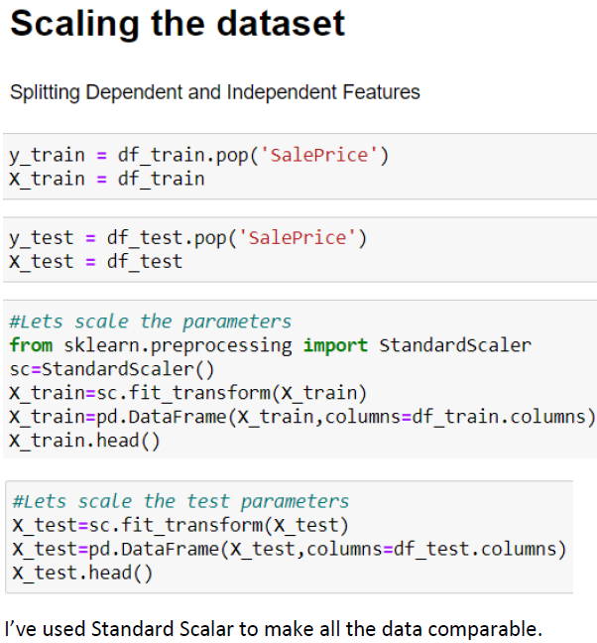
Examples of Distributions after Skewness Treatment
Standard Scalar

Slide 13
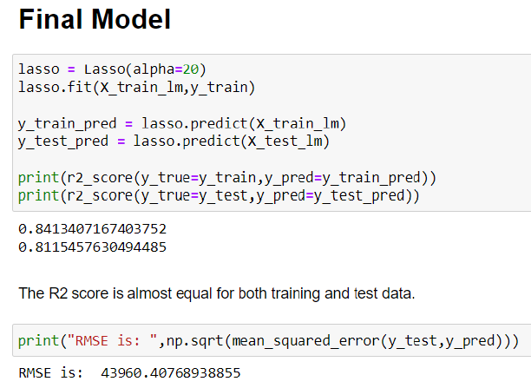
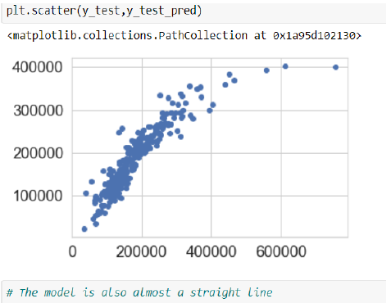
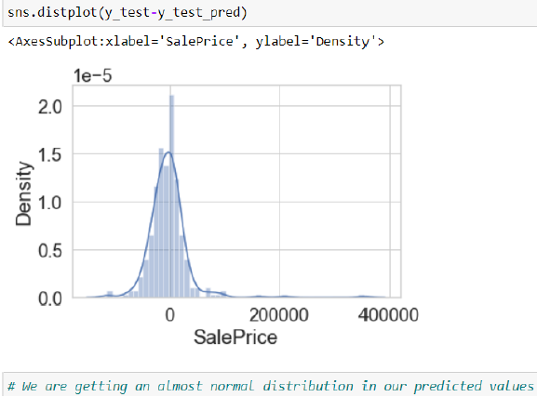

Slide 14
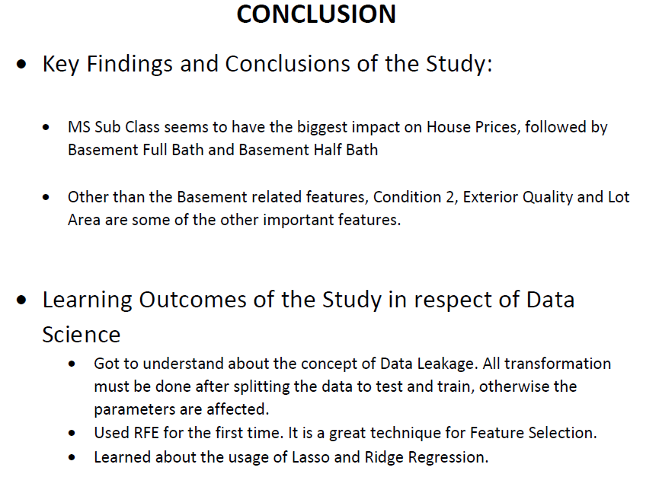

Slide 15
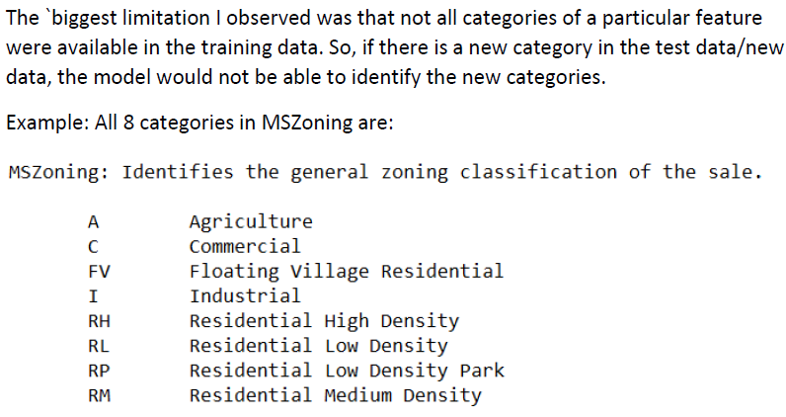
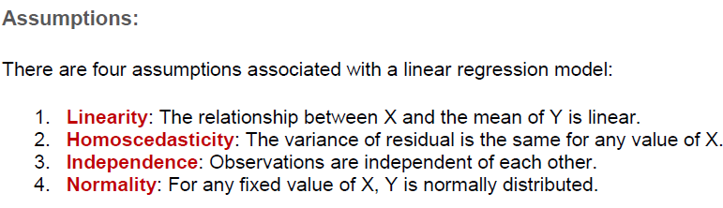
Limitations & Assumptions
For future, data collection should be done in a way that all such categories are included.

